Slide 1

THE LATEST RESULTS EXPLAINED
Intelligent Traffic Control via IoT-based Smart Speed Bump
By: A. Hosseini, A. Habibi, A. Karshenas, A. Amoomahdi, M. Mokhtari

Slide 2
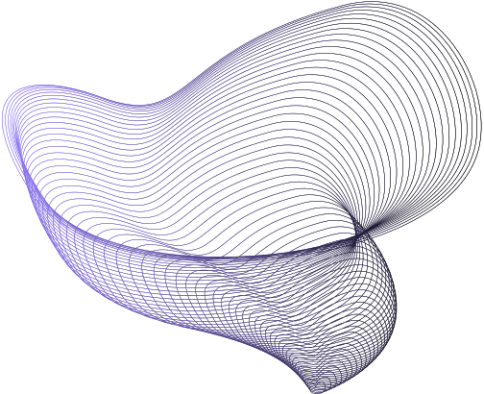
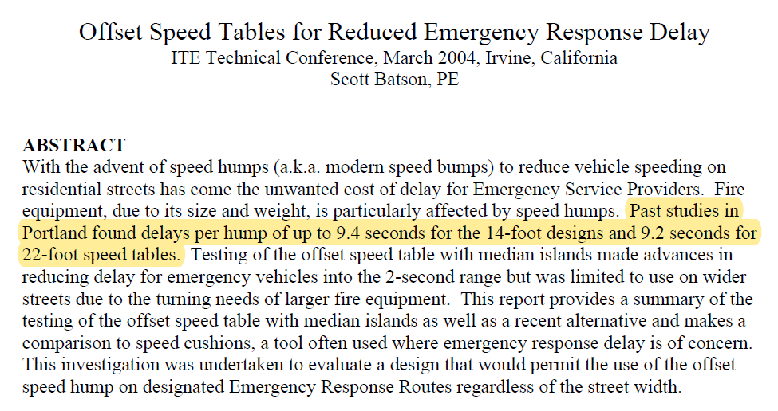

Slide 3

Notes:
SSBump Defined
The Smart Speed Bump (SSBump) represents an innovative solution to road safety concerns, with a primary aim to not only regulate speed but also facilitate the passage of emergency vehicles. While this may seem unconventional, the SSBump operates as a mandatory speed regulator for standard vehicles, simultaneously leveraging sensors and IoT-based technologies to minimize response time for emergency service providers and optimize traffic flow.

Slide 4
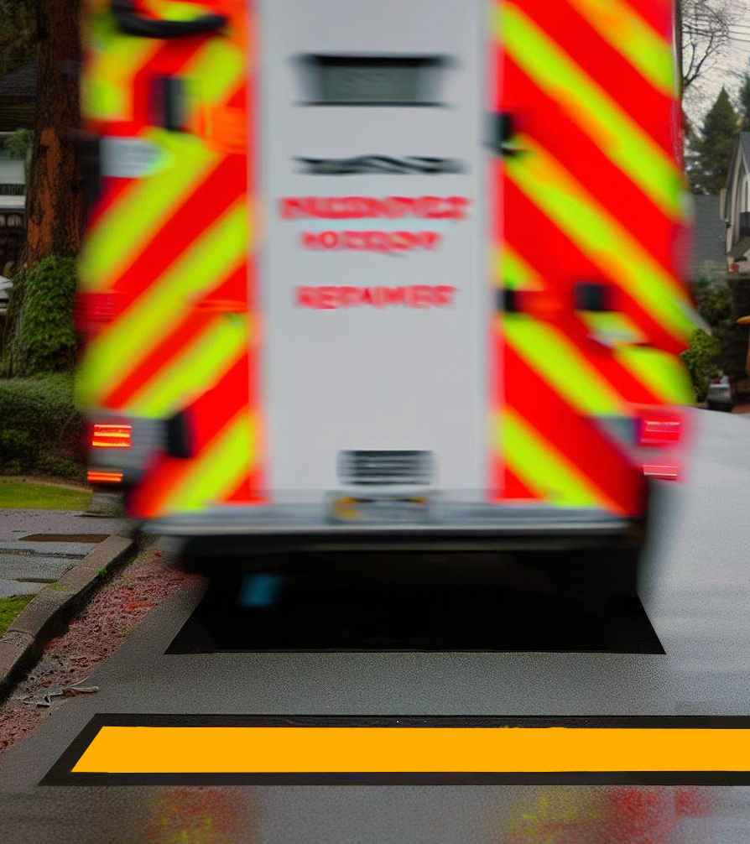
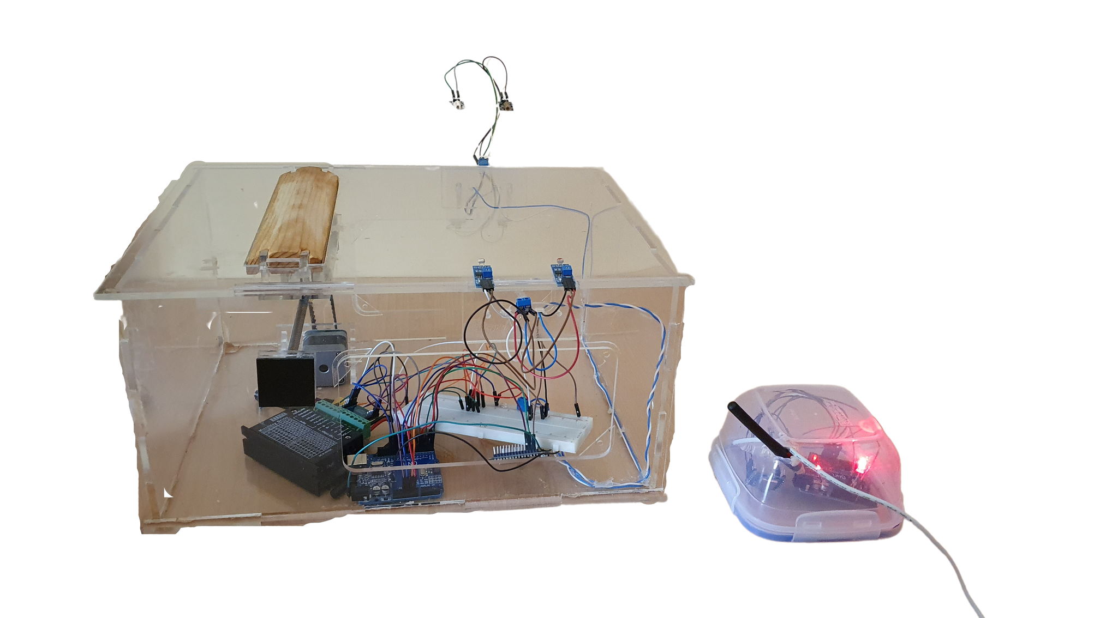
SSBump Defined
A new solution to road safety concerns.
Primary aim: facilitate the passage of emergency vehicles.
Sensors and IoT-based technologies are used to minimize response time for emergency service providers.
Optimizing congestion and intelligently controlling traffic flow.
Notes:
SSBump Defined
The Smart Speed Bump (SSBump) represents an innovative solution to road safety concerns, with a primary aim to not only regulate speed but also facilitate the passage of emergency vehicles. While this may seem unconventional, the SSBump operates as a mandatory speed regulator for standard vehicles, simultaneously leveraging sensors and IoT-based technologies to minimize response time for emergency service providers and optimize traffic flow.

Slide 5

Before
SSBump
After
SSBump
Intelligently designed to adapt to different vehicle types
Reducing speed for all vehicles, same functionality
Reducing emergency response delays and optimizing traffic flow
Emergency response delays can affect up to 10 seconds, a major weakness
Different modes of operation: manual, ideal, emergency, mixed
Leads to less CO2 emissions
No changes to speed bumps in 120 years
Used by city planners for data-driven infrastructure planning
Notes:
Before SSBump
Bumps were the same for all vehicles, so they have only one function: to reduce vehicle speed.
According to studies, emergency response delays can affect up to 10 seconds, so this is a major weakness.
There has been no significant progress in conventional bumps since the early 1900s, thus making them fuckin boring!
-----------------------------------
After SSBump
The SSMUBP system has been intelligently designed to adapt to varying vehicle types and respond accordingly.
It reduces emergency response delays, helps optimize traffic flow, and reduces congestion.
City planners use the system to gather data on traffic patterns and emergency vehicles for data-driven infrastructure planning.
Leads to less CO2 emissions
Different modes of operation: manual, ideal, emergency

Slide 6
How exactly does the SSBump work?
Notes:
The smart speed bump is a cutting-edge technological innovation that has been designed to expedite emergency response times. This innovative solution leverages the LoRa protocol to enable communication with adjacent emergency service vehicles. Upon confirmation of communication, the speed bumps receive a command to lower their height and descend to the ground completely, thus allowing faster emergency response times. Once the emergency vehicle has passed, the speed bump seamlessly returns to its original position.
Furthermore, the system is equipped with sensors that monitor the speed of passing vehicles. The collected data is then transmitted in real-time via the cellular network to a centralized server for analysis. The data gathered from the sensors enables informed decision-making by city planners regarding infrastructure planning. By providing real-time insights into traffic patterns and vehicle speeds, the system empowers planners to make data-driven decisions that optimize traffic flow and minimize congestion intelligently.

Slide 7

Tools and Technologies
SSBump uses various IoT-based hardware, technologies, and tools:
Boards
Sensors
Other Gadgets
SX1278 LoRa Module 433M
Arduino UNO CH340
ESP8266
Laser
LiDAR
GPS
Servo KH42JM2-B01 Motor
Microstep Driver (9~42V DC)
DC Power Adapter (12V-2.8A)
Wooden Bump Replica
Plexiglass Transparent Box

Slide 8
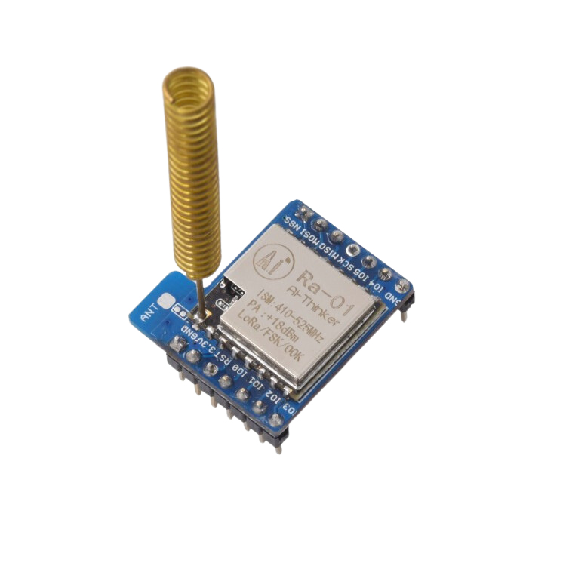

Application of LoRa
Notes:
Sigfox : ﺑﻪ دﻟﯿﻞ دﯾﺘﺎ رﯾﺖ ﺑﺴﯿﺎر ﭘﺎﯾﯿﻦ ﯾﻌﻨﯽ 140 ﭘﯿﺎم 12 ﺑﺎﯾﺘﯽ در روز ﻣﻮرد اﺳﺘﻔﺎده ﻧﯿﺴﺖ در اﺳﻼﯾﺪ ﻫﺎ ﮔﻔﺘﻪ ﺷﺪه 14 ﭘﯿﺎم در روز 26 ﺑﺎﯾﺘﯽ
: Licensed ﺑﻪ دﻟﯿﻞ ﻫﺰﯾﻨﻪ اﺿﺎﻓﻪ ﺗﺮ و flexibility ﭘﺎﯾﯿﻦ ﻣﻮرد ﻧﻈﺮ ﻣﺎ ﻧﯿﺴﺖ
ﺳﺎﯾﺮ ﮔﺰﯾﻨﻪ ﻫﺎ ﻣﺜﻞ ﺑﻠﻮﺗﻮث و Zigbee ﺑﻪ دﻟﯿﻞ رﻧﺞ ﭘﺎﯾﯿﻦ ﻗﺎﺑﻞ اﺳﺘﻔﺎده ﻧﯿﺴﺘﻨﺪ
ﺑﺮاي اﻓﺰاﯾﺶ اﻣﻨﯿﺖ ارﺗﺒﺎط ﻟﻮرا ﻣﯽ ﺗﻮاﻧﯿﻢ از AES Advanced encryption Standard اﺳﺘﻔﺎده ﮐﻨﯿﻢ
ﺑﻪ دﻟﯿﻞ unlicensed ﺑﻮدن ﻟﻮرا 433 mhzاﻣﮑﺎن interference وﺟﻮد دارد
ﻣﯿﺘﻮان از ﻣﮑﺎﻧﯿﺰم Adaptive data rate ﺑﺮاي زﻣﺎﻧﯽ ﮐﻪ ﭘﮑﺖ ﻫﺎ ﮔﻢ ﻣﯽ ﺷﻮﻧﺪ و Interference وﺟﻮد دارد اﺳﺘﻔﺎده ﮐﺮد ﺗﺎ ﻧﺮخ ارﺳﺎﻟﯽ و زﻣﺎن ارﺳﺎل ﺑﯿﻦ ارﺳﺎل ﻫﺎ ﺑﺎ ﺗﻮﺟﻪ ﺑﻪ وﺿﻌﯿﺖ ﺷﺒﮑﻪ ﺗﻐﯿﯿﺮ ﮐﻨﺪ

Slide 9



Application of Cellular Networks
Notes:
دﻻﯾﻞ اﺳﺘﻔﺎده از 5Gدر ﻧﺴﺨﻪ real
ﮔﺴﺘﺮدﮔﯽ ﻣﺎژول ﻫﺎي دﺳﺖ اﻧﺪاز در ﺳﻄﺢ ﺷﻬﺮ ﮐﻪ ﺑﺮاي اﺗﺼﺎل ﺑﻪ اﯾﻨﺘﺮﻧﺖ ﻧﯿﺎز ﺑﻪ ﺗﮑﻨﻮﻟﻮژي ﺑﯽ ﺳﯿﻢ و ﭘﻮﺷﺶ دﻫﯽ ﮔﺴﺘﺮده دارﯾﻢ
ارﺳﺎل دﯾﺘﺎﻫﺎي ﺗ ﺠﻤﯿﻌﯽ ﺑﻪ ﺳﺮور در ﮐﻤﺘﺮﯾﻦ زﻣﺎن ﻣﻤﮑﻦ
در ﺣﺎﻟﯽ ﮐﻪ اﻣﮑﺎن اﺳﺘﻔﺎده از ارﺗﺒﺎﻃﺎت ﺳﯿﻤﯽ ﺑﻪ دﻟﯿﻞ ﻣﮑﺎن دﺳﺖ اﻧﺪاز وﺟﻮد ﻧﺪارد و ﭘﻮﺷﺶ دﻫﯽ wifi ﻧﯿﺰ ﻧﯿﺎز ﻣﺎ راﺗﺎﻣﯿﻦ ﻧﻤﯽ ﮐﻨﺪ
اﻣﺎ در ﻧﺴﺨﻪ دﻣﻮي ﺳﺎﺧﺘﻪ ﺷﺪه ﺑﻪ دﻟﯿﻞ ﻣﺤﺪودﯾﺖ ﮐﻤﺘﺮ از wifi و ﻣﺎژول esp8266 اﺳﺘﻔﺎده ﮐﺮده اﯾﻢ

Slide 10


IoT Platforms
Notes:
دﻻﯾﻞ اﻧﺘﺨﺎب blynk
اﻣﮑﺎن اﺳﺘﻔﺎده از ﻃﯿﻒ وﺳﯿﻊ ﺳﺨﺖ اﻓﺰار ﻫﺎ ﺑﻪ د ﻟﯿﻞ ﺳﺎزﮔﺎري ﺑﺎﻻي blynk ﺑﺎ ﺳﺨﺖ اﻓﺰار ﻫﺎي ﻣﺨﺘﻠﻒ در ﺣﺎﻟﯽ ﮐﻪ arduino iot cloud از ﮐﺘﺎﺑﺨﺎﻧﻪ ﻫﺎ و sdk و ﺳﺨﺖ اﻓﺰار ﻫﺎي ﻣﺤﺪود ﺗﺮي ﭘﺸﺘﯿﺒﺎﻧﯽ ﻣﯽ ﮐﻨﺪ
open source ﺑﻮدن و اﻣﮑﺎن اﺳﺘﻔﺎده از اﭘﻠﯿﮑﯿﺸﻦ ﻣﻮﺑﺎﯾﻞ و ﺳﺮور اﺑﺮي ﺑﺮاي راه اﻧﺪازي ﭘﺮوژه ﻫﺎي iot
ﻣﺤﯿﻂ ﺳﺎده و User friendly ﺑﺎ ﻗﺎﺑﻠﯿﺖ drag and drop
تحریم

Slide 11
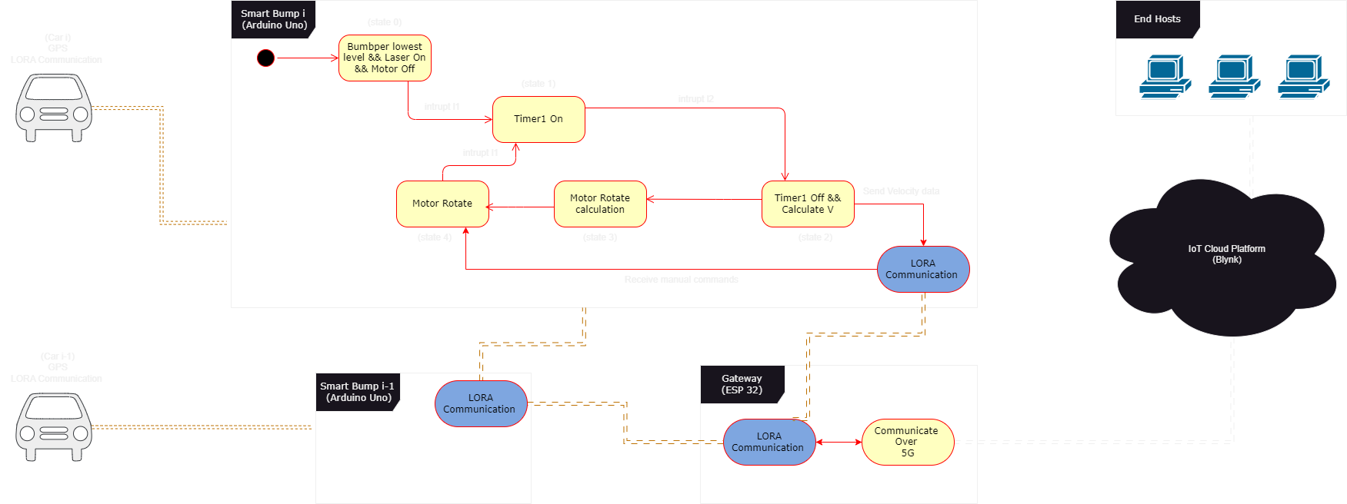
Architecture of the SSBump

Slide 12

Time to watch a Demo!

Slide 13
Future Prospects
of the SSBump

Slide 14
Social Prospects
Integration with autonomous vehicle technology
Integration with smart city initiatives
"Revolutionizing traffic safety and emergency response, the integration of smart speed bump technology into urban communities creates a safer and more sustainable future for all."
Notes:
Integration with autonomous vehicle technology
The system can integrate with autonomous vehicles to improve traffic management, reduce congestion, and minimize emergency response times by providing real-time data on traffic patterns and enabling autonomous vehicles to adjust their speed and trajectory accordingly.
----
Integration with smart city initiatives
The smart speed bump technology can be integrated into smart city initiatives, which are focused on using data and technology to make urban areas more efficient, sustainable, and livable. This can improve the overall quality of life for citizens by reducing congestion and improving emergency response times.

Slide 15
Technical Prospects
Integration with predictive analytics
Integration of advanced sensor technologies
"Constant innovation and technological advancements drive the system's ongoing improvement and optimization, allowing it to achieve higher levels of accuracy, reliability, and efficiency."
Integration with energy harvesting technology
Notes:
Integration with predictive analytics
The system can benefit from the use of machine learning algorithms to analyze historical data on traffic patterns and emergency response times. This data is used to create predictive models that can anticipate future traffic patterns and emergency response needs.
--
Integration of advanced sensor technologies
Seeking advancement through the use latest sensor technologies such as radar or ultrasonic sensors, as well as other communication protocols such as 5.25G, in order to provide more precise measurements and forecast more accurately, reliably, quickly, and more efficiently.
---
Integration with energy harvesting technology
The system can be integrated with energy harvesting technology, such as solar panels or kinetic energy harvesters, to power the system without the need for external energy sources. This would make the technology more sustainable and cost-effective in the long term.

Slide 16

"Any sufficiently advanced technology is equivalent to magic."
SIR ARTHUR C. CLARKE

Slide 17

Do you have
any questions?
Ask us now! Hope you learned something new.

Slide 18

Thanks for watching!

